Slide 1
Corona Virus Analysis
UsiNg SQL

Slide 2
Table of contents:
1.Introduction
2. Problem Statement
3.Overview
4.Dataset Explanation
5.Dataset Exploration using SQL

Slide 3
Introduction:
COVID-19 is a highly contagious respiratory illness caused by the SARS-CoV-2 virus. The virus primarily spreads through respiratory droplets and aerosols. COVID-19 can cause a wide range of symptoms, from mild to severe. As of early 2023, over 6 million deaths worldwide have been attributed to COVID-19. Vaccination remains a key strategy for preventing severe illness and death.

Slide 4
Problem Statement:
The CORONA VIRUS pandemic has had a significant impact on public health and has created an urgent need for data-driven insights to understand the spread of the virus. This analysis uses SQL to showcase the key insights of its spread globally in year 2020&2021.

Slide 5
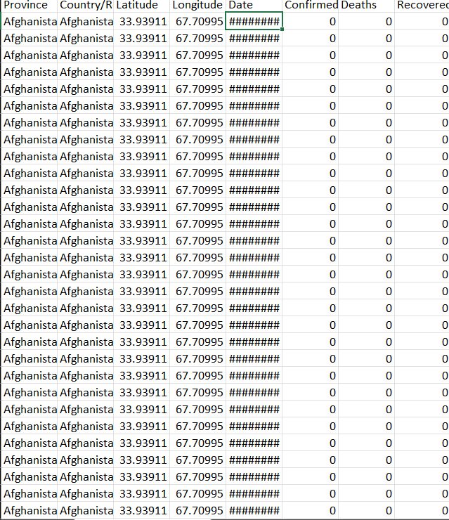
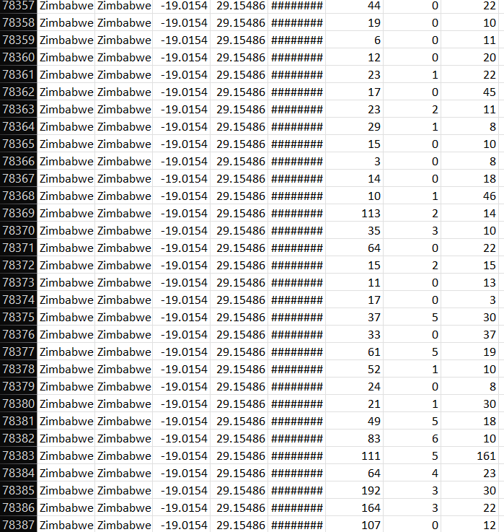
Dataset Overview:

Slide 6
Dataset Explanation:
Province: Geographic subdivision within a country/region.
Country/Region: Geographic entity where data is recorded.
Latitude: North-south position on Earth's surface.
Longitude: East-west position on Earth's surface.
Date: Recorded date of CORONA VIRUS data.
Confirmed: Number of diagnosed CORONA VIRUS cases.
Deaths: Number of CORONA VIRUS related deaths.
Recovered: Number of recovered CORONA VIRUS cases.

Slide 7
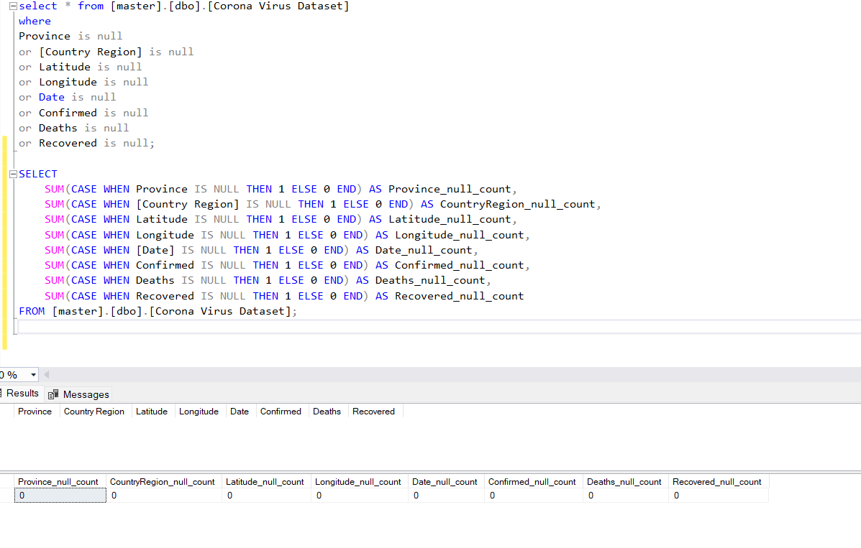
Data Exploration:
Q1. Write a code to check NULL values.

Slide 8
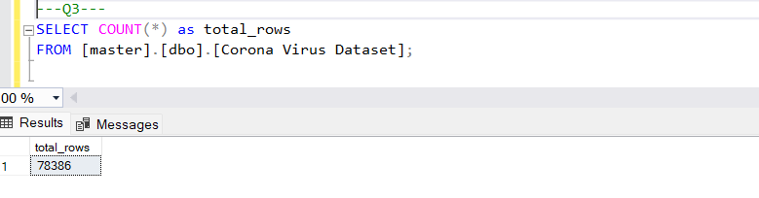
Q3. check total number of rows.

Slide 9
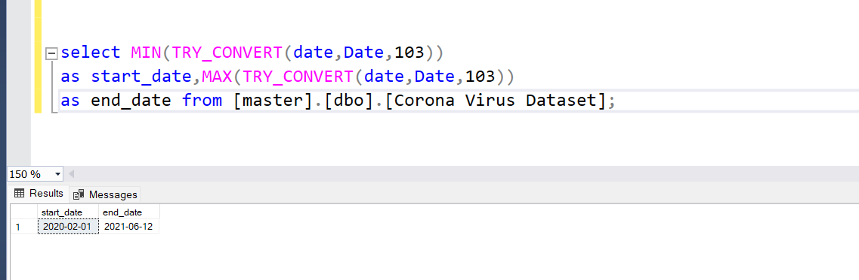
Q4. Check what is start_date and end_date.

Slide 10
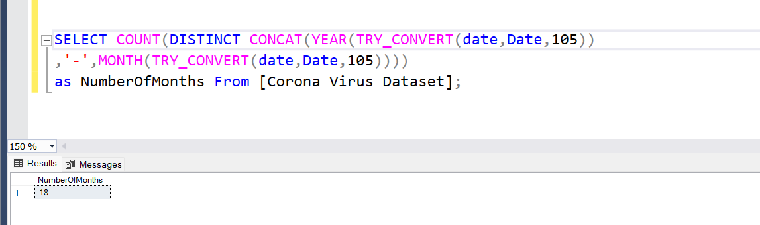
Q5. Number of month present in dataset.

Slide 11
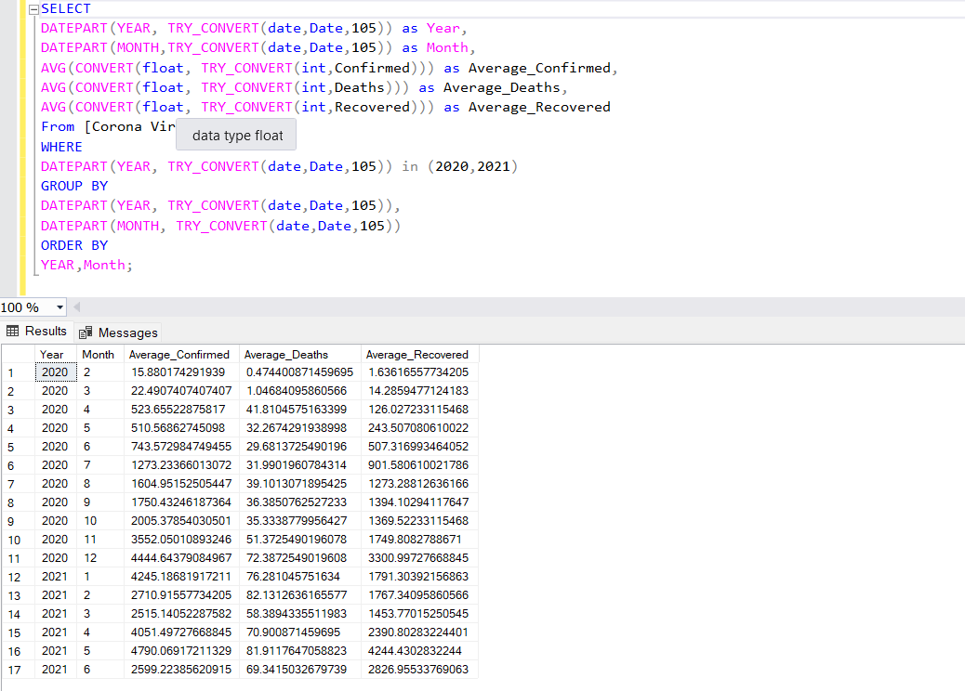
Q6. Find monthly average for confirmed, deaths, recovered.

Slide 12
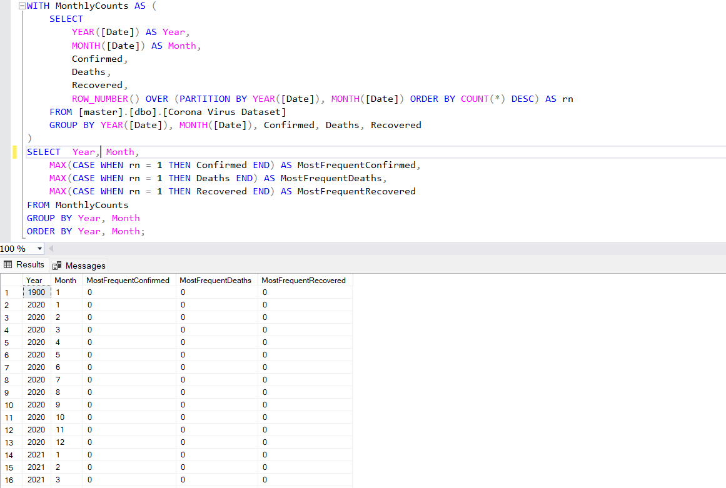
Q7. Find most frequent value for confirmed, deaths, recovered each month.

Slide 13
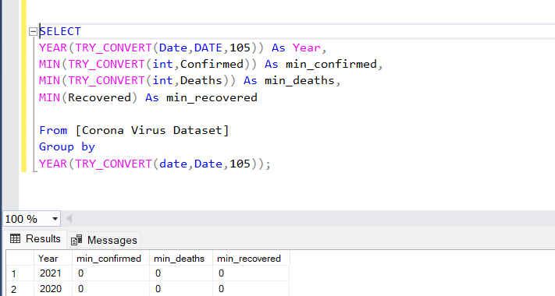
Q8. Find minimum values for confirmed, deaths, recovered per year

Slide 14
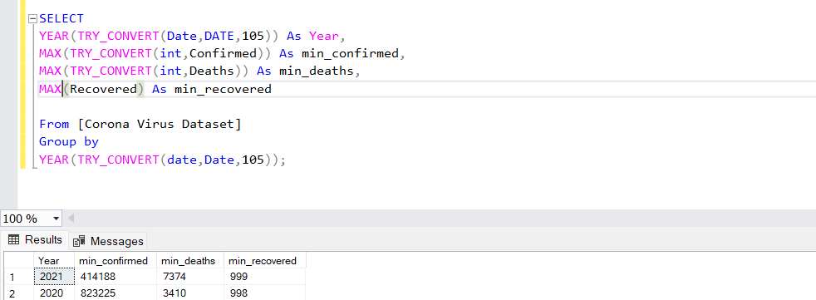
Q9. Find maximum values of confirmed, deaths, recovered per year

Slide 15
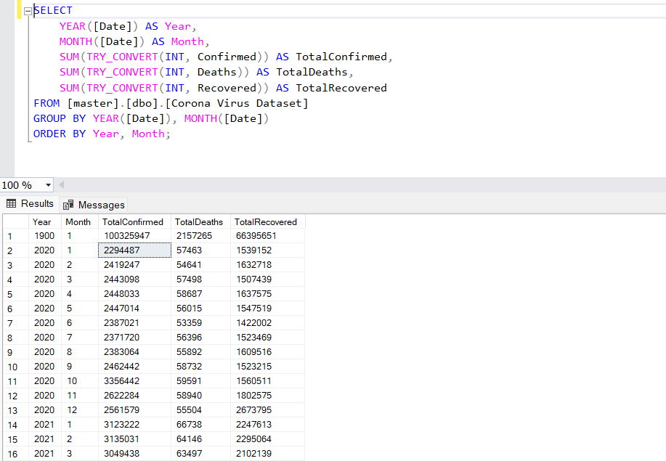
Q10. The total number of case of confirmed, deaths, recovered each month

Slide 16
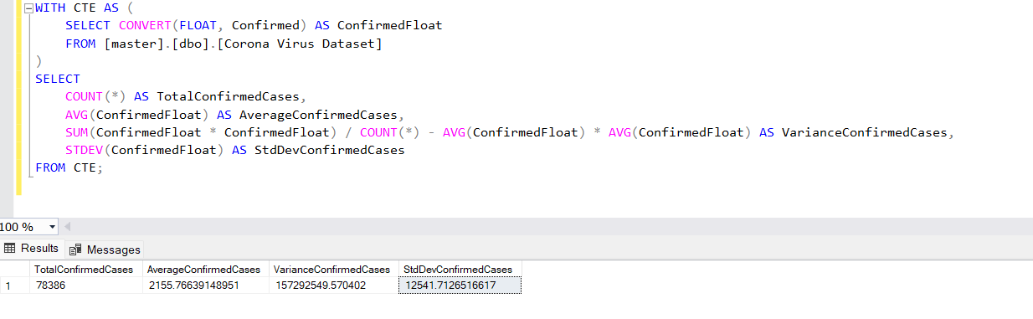
Q11. Check how corona virus spread out with respect to confirmed case

Slide 17
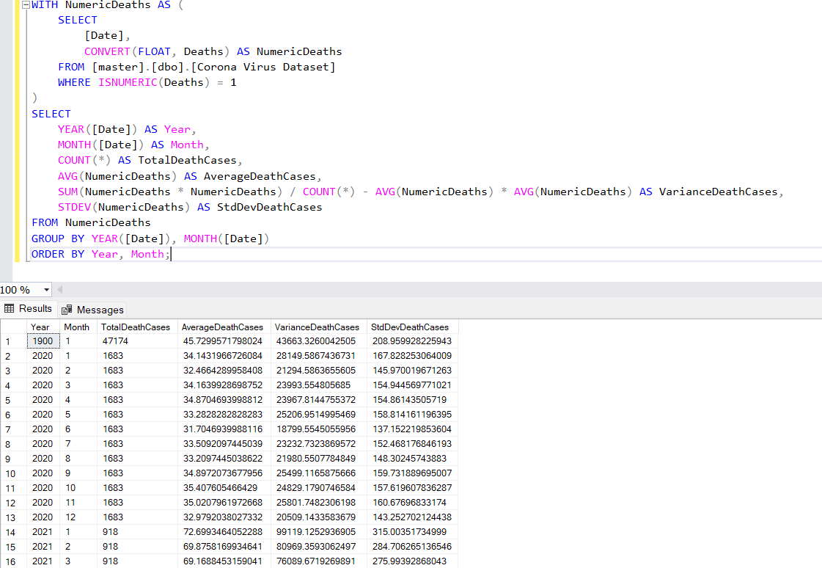
Q12. Check how corona virus spread out with respect to death case per month

Slide 18
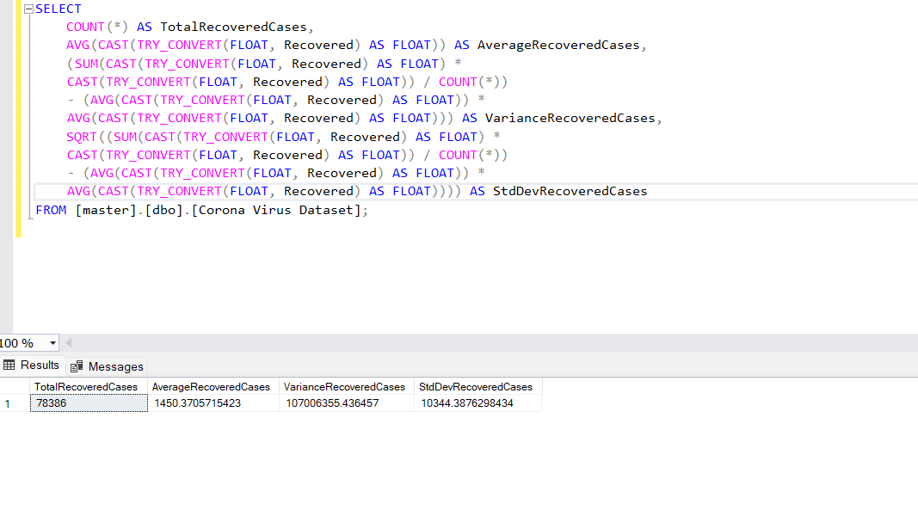
Q13. Check how corona virus spread out with respect to recovered case

Slide 19
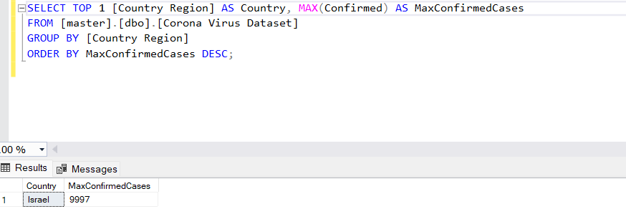
Q14. Find Country having highest number of the Confirmed case .

Slide 20
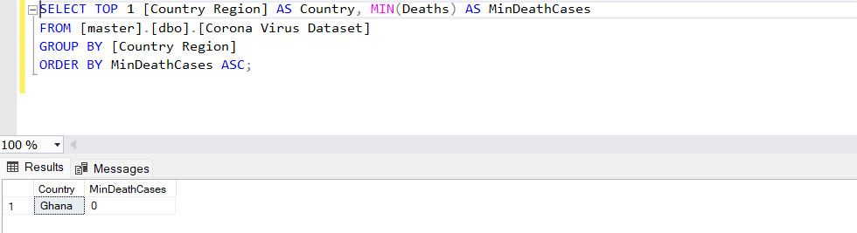
Q15. Find Country having lowest number of the death case

Slide 21
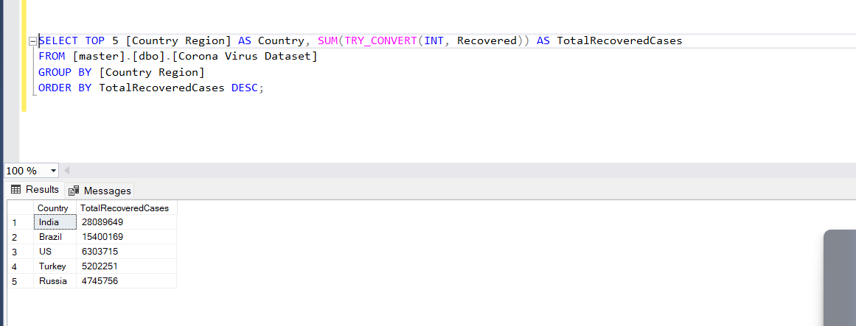
Q16. Find top 5 countries having highest recovered case

Slide 22
THANK YOU

